Slide 1
@AtlCodeCamp
httpS://AtlantaCodeCamp.com/2016

Slide 2




Platinum Sponsors

Slide 3







Gold Sponsors

Slide 4





SWAG Sponsors
Silver Sponsors

Slide 5
Surveys and Prizes
Please complete the session and event surveys!
1 ticket per session survey
1 ticket for the event survey
1 ticket for completing the booth game
Drawing for prizes begins at 5pm in Q202

Slide 6



Web Optimization
This slide deck is available on
https://github.com/GTC-JS/ExtraPresentations
Ozgur Ozturk, PhD
@DrOzTurk
github.com/DrOzturk
linkedin.com/in/OzgurOzturk
DrOzTurk.com

Slide 7



Data Scientist at CareerBuilder & Adjunct Web Programming Instructor at GTC
https://www.careerbuildercareers.com

Slide 8

Thanks to Manning & Jeremy Wagner coupon: ACC2016 40% off all formats, expiration: November 15
https://www.manning.com/books/web-performance-in-action

Slide 9
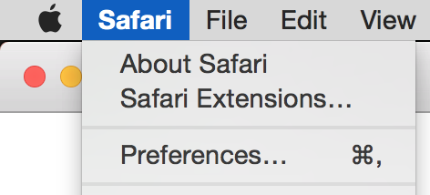
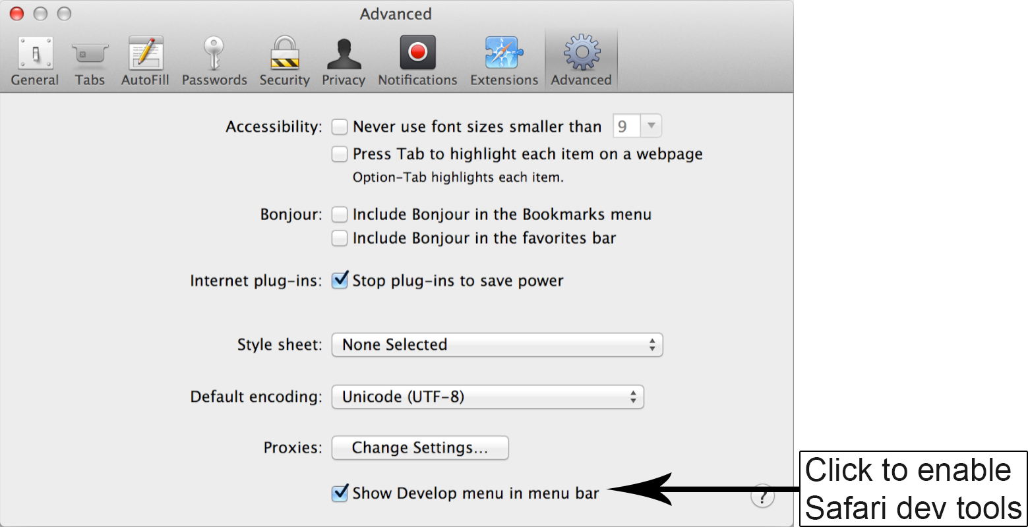
Enable Dev Tools on Safari

Slide 10
Developer Tools
Keyboard Shortcut
WIN: F12, or Ctrl + Shift + I
MAC: Cmd + Opt + I

Slide 11
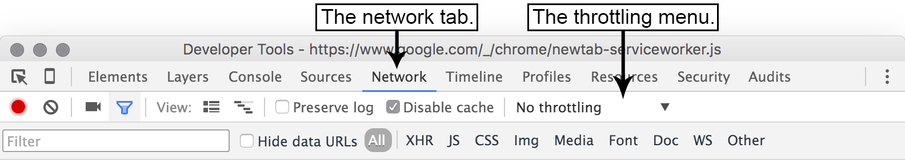
Simulate Network Conditions

Slide 12
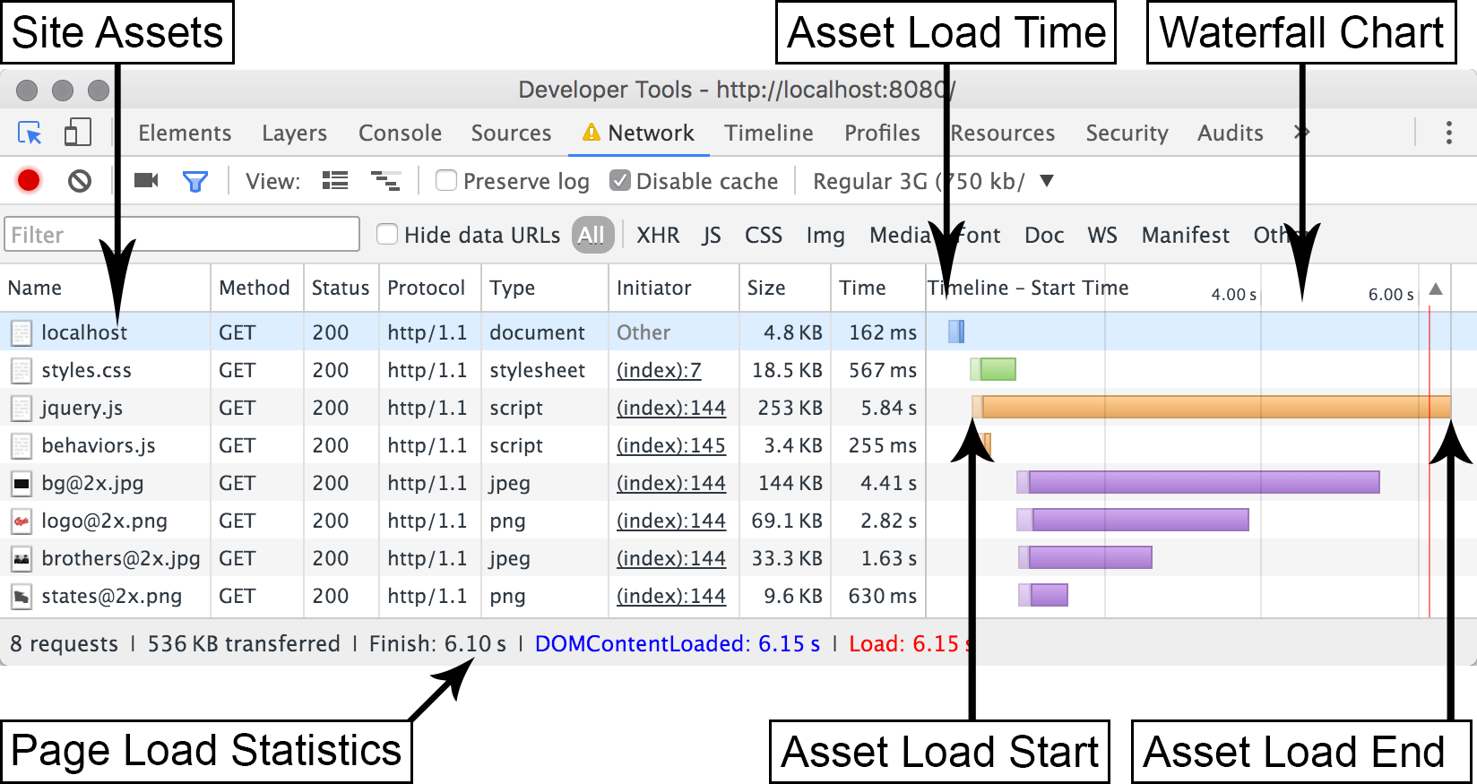
Waterfall Charts
Analyze amount of requests, size of website in kilobytes, time to load
Notes:
Safari network tab lacks waterfall graph. It shows a table with latency, start time and duration columns

Slide 13
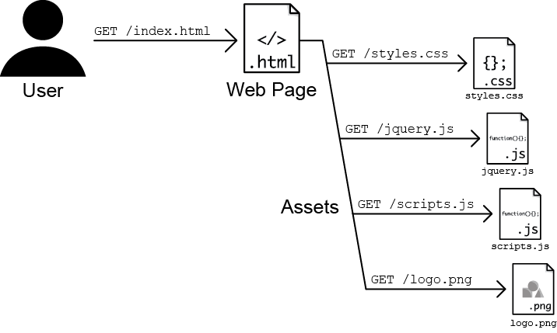
Asset Requests by Browser from Server
Notes:
As the web browser downloads the HTML, it discovers a <link> tag to a style sheet, a couple of <script> tags linking to some JavaScript files, and an <img> tag referring to an image.
Can be 100s of assets.

Slide 14
Node and Git
nodejs.org
Hosted npm packages listed on npmjs.com
> npm install express
installs the Express framework to your current directory, which we use to create a simple web server
git-scm.com/downloads
> git clone https://github.com/malchata/ch1-coyle.git
> cd ch1-coyle
End result: git checkout -f optimized
> node http.js
Visit http://localhost:8080/

Slide 15
Optimization Steps
Minifying the assets (CSS, JavaScript, HTML…)
Optimize the images preserving their visual integrity
Compression on the server for text assets

Slide 16
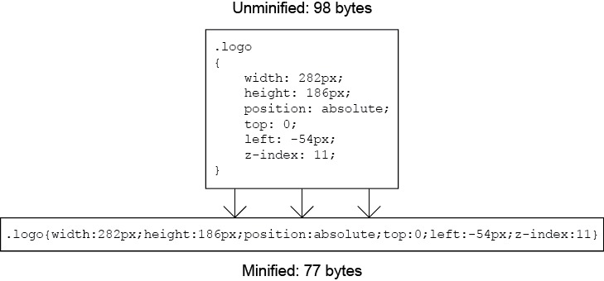
Minification
Strip all white space and characters not unnecessary for functionality

Slide 17
Minification tools
> npm install minifier –g # for js and css filed
> npm install html-minify –g # for html files
> cd css
> minify styles.css
Minification complete
> ls -la
18712 Jun 18 03:56 styles.css
16043 Jun 18 04:06 styles.min.css
> mv index.html index.src.html
> htmlminify index.src.html > index.html
Notes:
cd ../js
minify jquery.js
minify behaviors.js

Slide 18
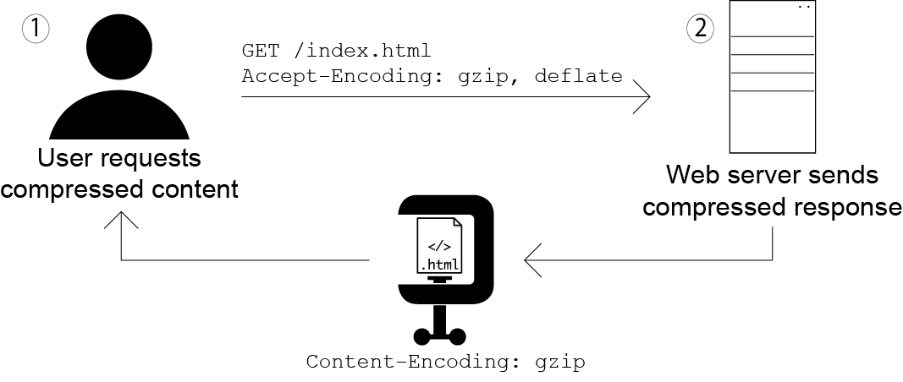
Compression

Slide 19
Adding compression
npm install compression
Edit http.js
Refer to library
var compression = require("compression");
Add it to your app on server
app.use(compression());

Slide 20
http.js changes
var express = require("express");
var compression = require("compression"); //imports module
var app = express();
// Run static server
app.use(compression()); //hooks compression module to web server
app.use(express.static(__dirname));
app.listen(8080);

Slide 21
Other Servers
For Apache, edit httpd.conf check if the module is available, enable on media/MIME types:
<IfModule mod_deflate.c>
AddOutputFilterByType DEFLATE text/html text/css text/javascript
</IfModule>
For IIS, use inetmgr GUI tool
Don’t enable compression on already compressed files
like JPEG, PNG, GIF images and WOFF/WOFF2 font files.
Notes:
These file types already use compression when they're encoded.

Slide 22
Image Compression
tinyPNG.com
Ch 6 mentions local tools
Checkout optimized branch and see new waterfall
git checkout -f optimized

Slide 23
Ch 2: Assesment Tools
- Google PageSpeed Insights
- Network request inspectors for timing information for assets
- Rendering profilers to diagnose poor rendering performance
- Benchmarking JavaScript code
- Emulating different device and internet connection

Slide 24
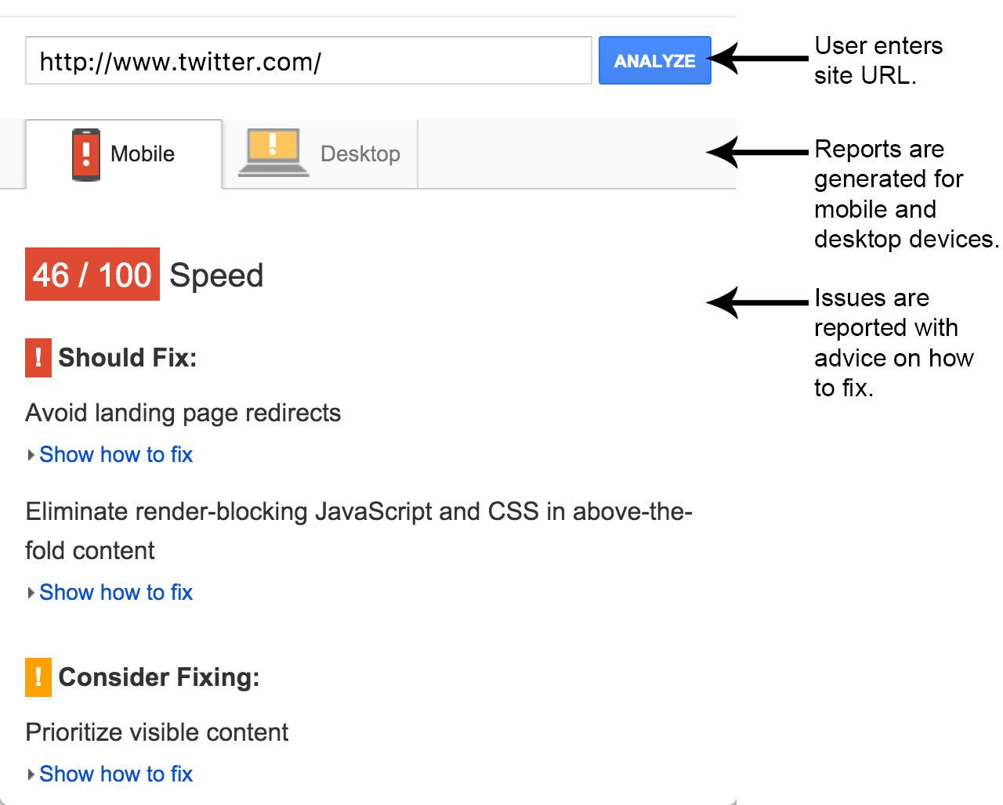
Google PageSpeed Insights
https://developers.google.com/speed/pagespeed/insights/
Notes:
compare
http://jlwagner.net/webopt/ch01-exercise-pre-optimization
http://jlwagner.net/webopt/ch01-exercise-post-optimization

Slide 25
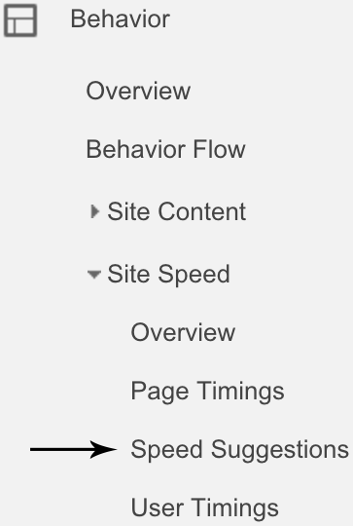
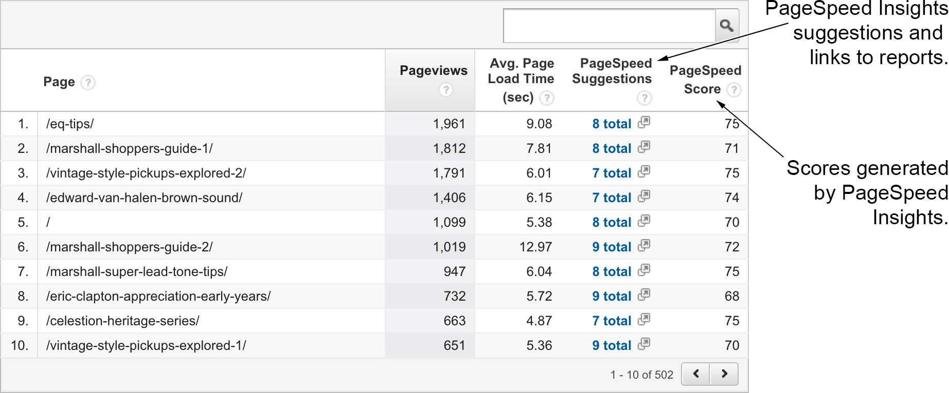
Accumalated Page Speed Insights from Google Analytics
http://www.google.com/analytics

Slide 26
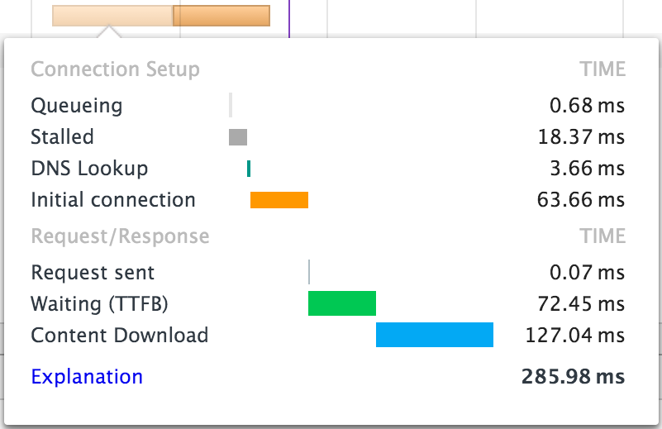
Dev Tools Network Tab
Waterfall Chart for each resource
TTFB: Time to First Byte

Slide 27
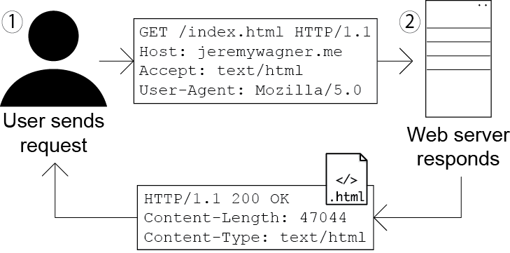
Headers

Slide 28
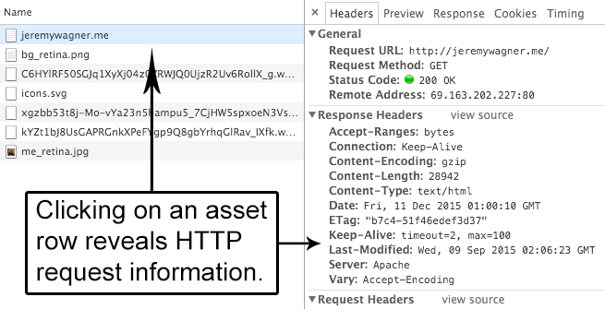
Viewing Headers
Content Encoding, caching, cookies…

Slide 29
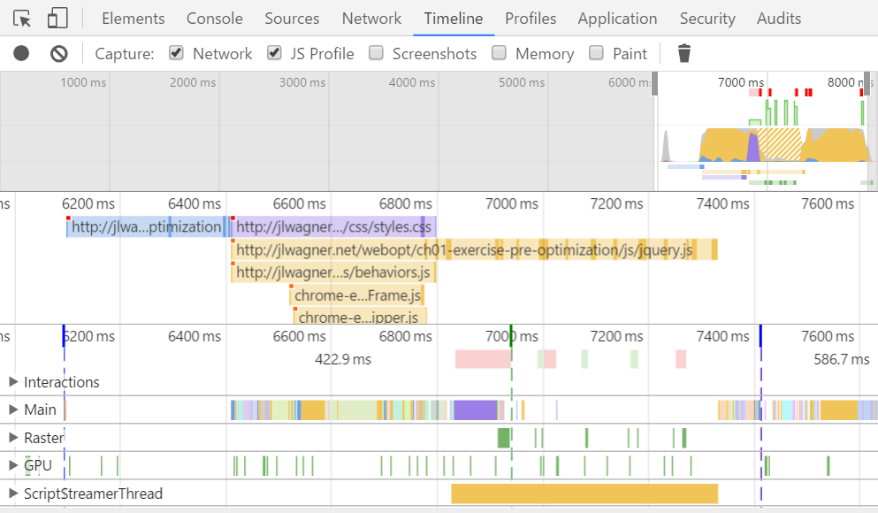
Timeline View

Slide 30
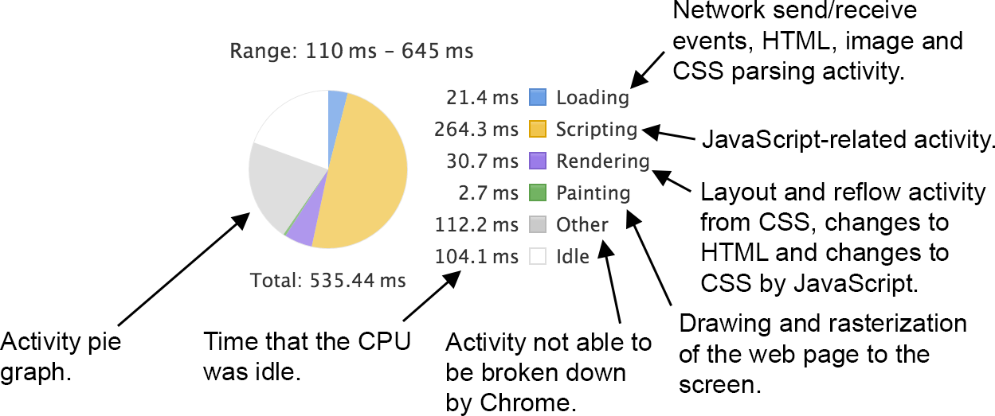
Pie Chart in Summary Tab & Color Legend

Slide 31
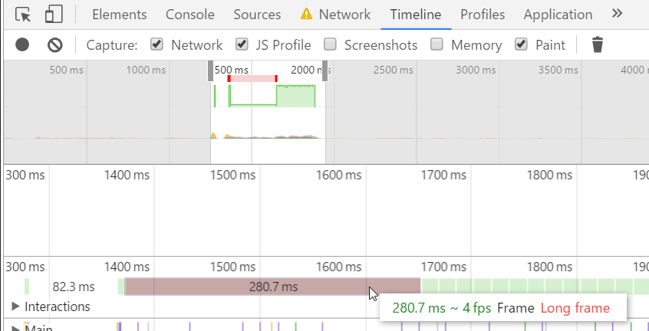
Janky Fames Marked Red
Notes:
git clone https://github.com/webopt/ch2-jank.git

Slide 32
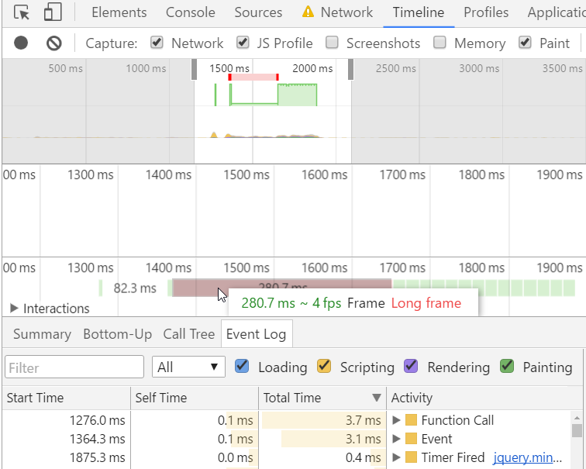
Janky Frames Marked Red
Janky: Low fps
Use Event Log tab
“Timer Fired”
means setTimeout/ setInterval call
very resource intensive
Use CSS Transform when possible
Notes:
Fixed example:
git checkout -f css-transition
styles.css in your text editor and go to line 557

Slide 33
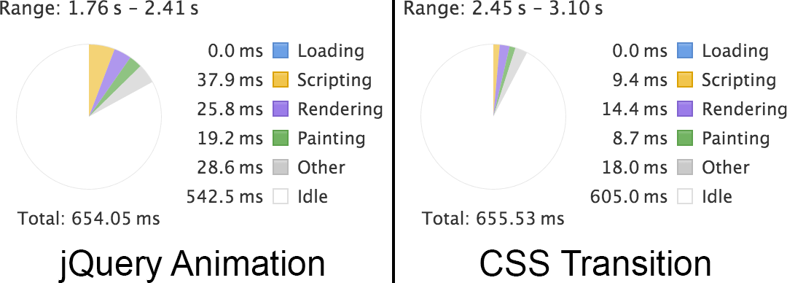
CSS Transform
Solves jittery animation & saves CPU consumption

Slide 34
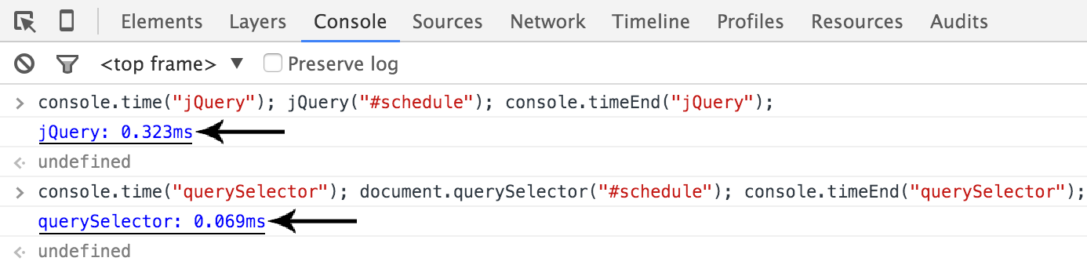
More Console API to Benchmark Code
console.timestamp
console.time("querySelector"); document.querySelector("#schedule"); console.timeEnd("querySelector");
Notes:
Demo timestamp feature
In behaviors.js
go to line 33.
//jQuery click event handler that opens up the scheduling modal:
$("#schedule").click(function(){
Inside of the function for this event handler, add a new line with the following code:
console.timeStamp("Modal open.");

Slide 35
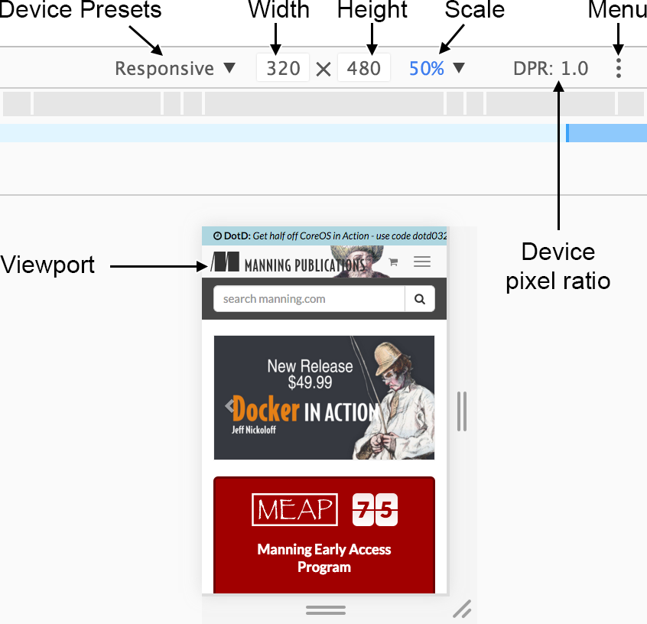
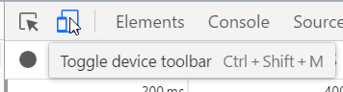
Device Simulation Mode in Chrome
Command+Shift+M (Mac)
Ctrl+Shift+M (Win)

Slide 36
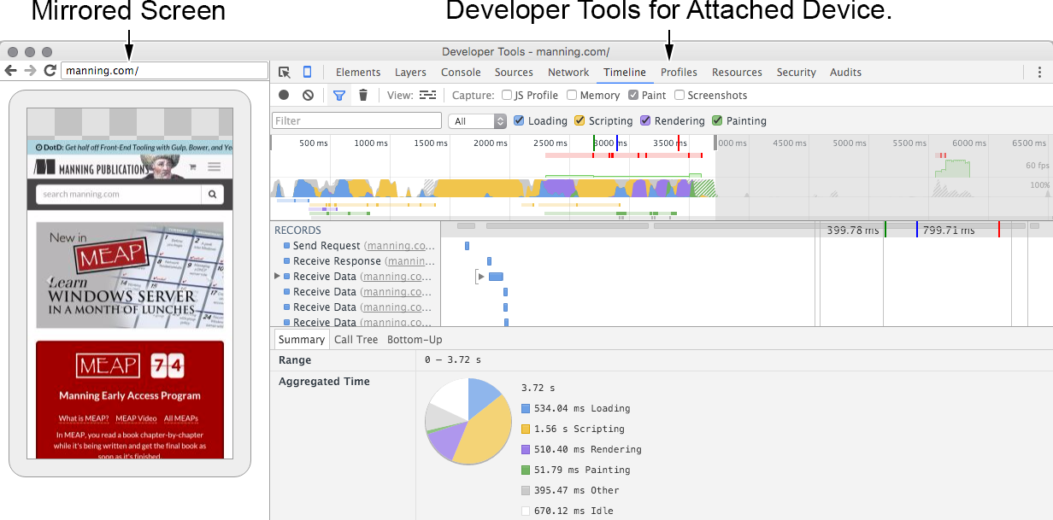
Remote Debugging

Slide 37
Ch 3:Optimizing CSS
- CSS File Size (Shorthand CSS properties, shallow CSS selectors, DRY principle.)
- Segment your CSS based on how your users access your website.
- Mobile-first responsive web design.
- Performant CSS selectors
- Flexbox layout engine
- CSS transitions.

Slide 38
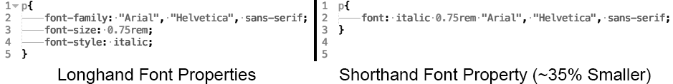
Shorthand CSS properties https://www.w3.org/community/webed/wiki/CSS_shorthand_reference
Margin ex:
margin-top: 0;
margin-right: 0;
margin-bottom: -8px;
margin-left: 0;
margin: 0 0 -8px;
Notes:
git clone https://github.com/webopt/ch3-css.git
cd ch3-css
npm install
node http.js
---
Optimized:
git checkout -f shorthand

Slide 39
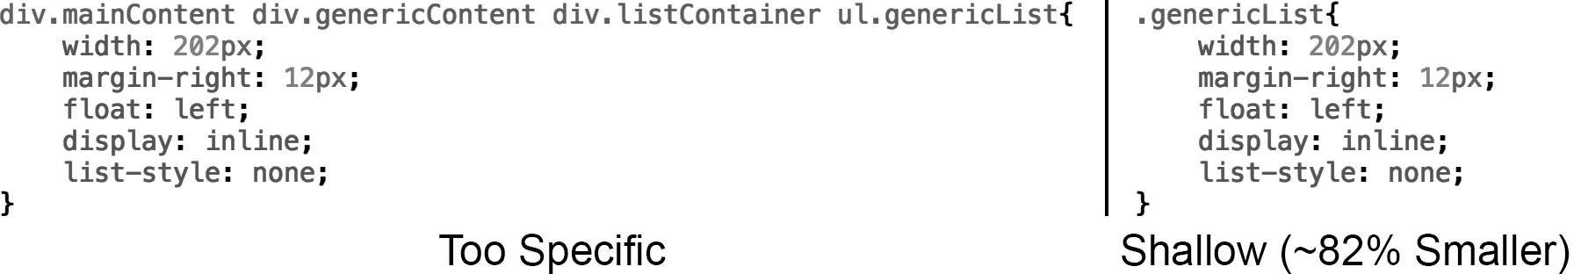
Use Shallow CSS Selectors
Can remove unused CSS styles using uncss node program
npm install -g uncss
uncss http://localhost:8080 -i .modal.open > css/styles.clean.css
Notes:
git checkout -f selectors see styles.css

Slide 40
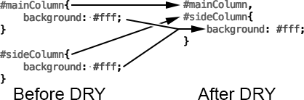
Go DRY
csscss ruby gem to remove redundancies
Notes:
http://rubyinstaller.org/downloads
csscss styles.css –v –-no-match-shorthand

Slide 41
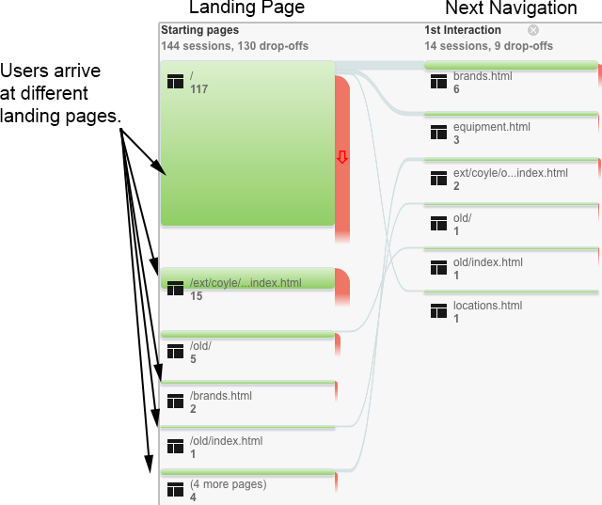
Segmenting CSS file
Single file -> slower on first page, faster on subsequent pages
data-driven method: the path users take through your website, from site’s analytics

Slide 42
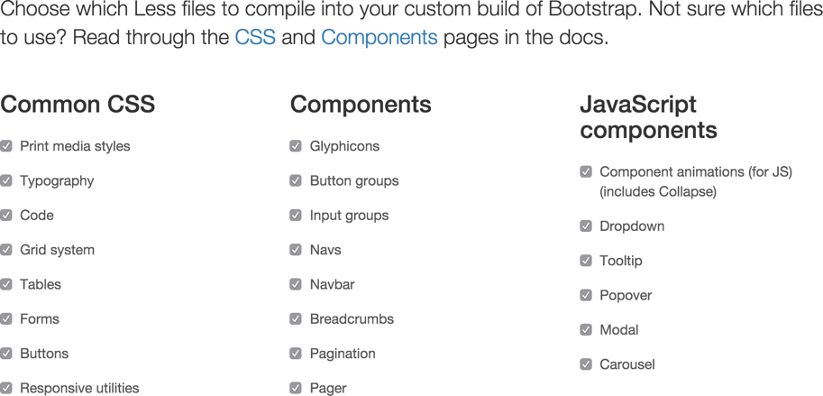
Customize frameworks
Eg: Bootstrap

Slide 43
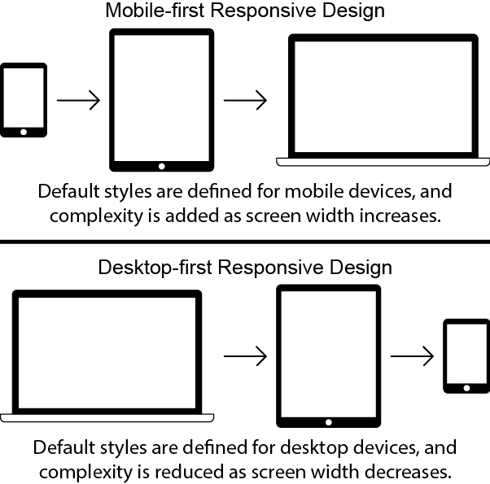
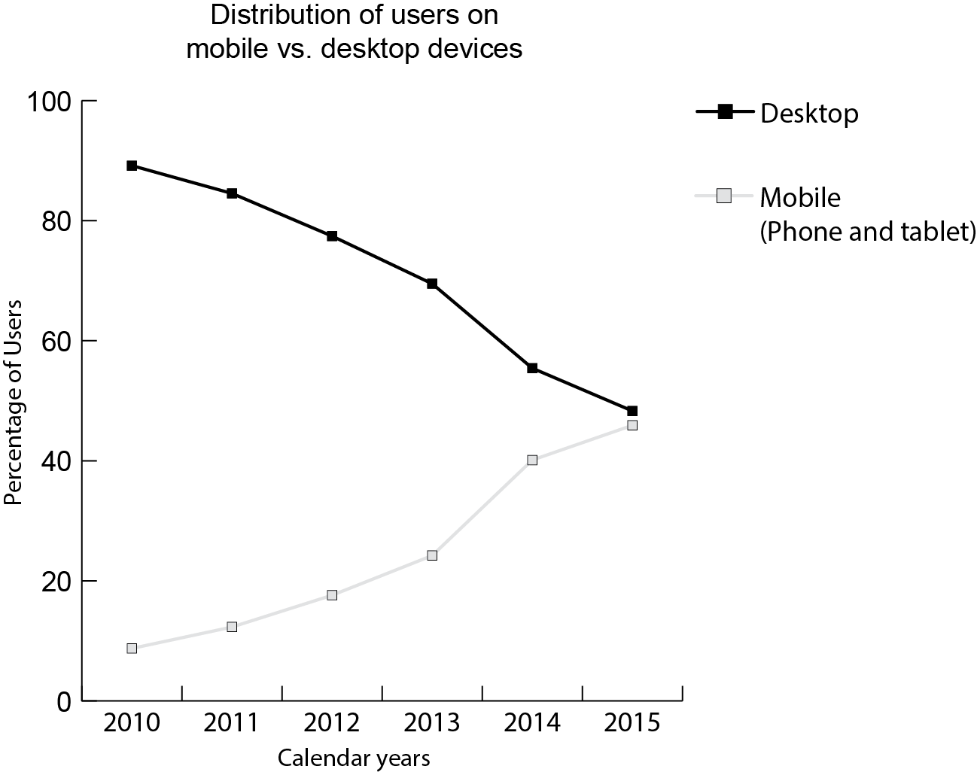
Mobile First
Notes:
Mobile means lower power
Mobile first makes design more focused on more important features

Slide 44
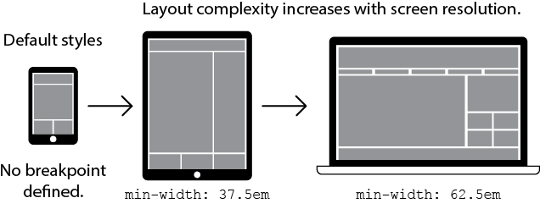
Media Queries
// CSS resets
html{
font-size: 16px; // Default document font size
//(em values are calculated from this default)
}
//Default mobile styles (not contained in any breakpoint)
@media screen and (min-width 37.5em){ /* 600px / 16px */
//Tablet-specific styles.
}
@media screen and (min-width 62.5em){ /* 1000px / 16px */
//Desktop-specific styles.
}
Add to <head> element in html file
<meta name="viewport" content="width=device-width,initial-scale=1">
Google’s tool to check if mobile friendly:
https://www.google.com/webmasters/tools/mobile-friendly/

Slide 45
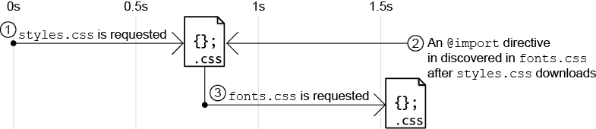
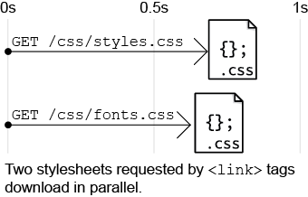
CSS Performance tips
rely on the HTML <link> tag instead of css @import
LESS and SASS @import is different. It is read by the compiler and used to bundle LESS/SASS files together.

Slide 46
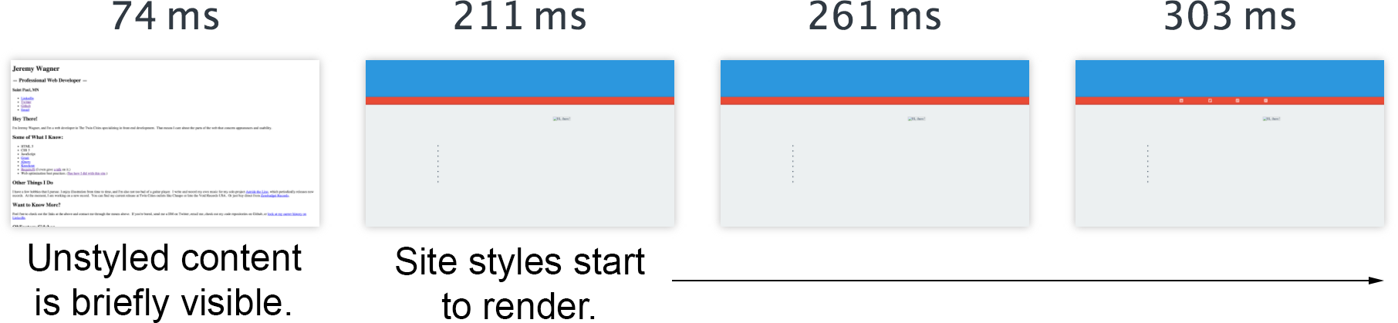
Flash of Unstyled Content
load CSS <link> tag in your <head> element, otherwise

Slide 47
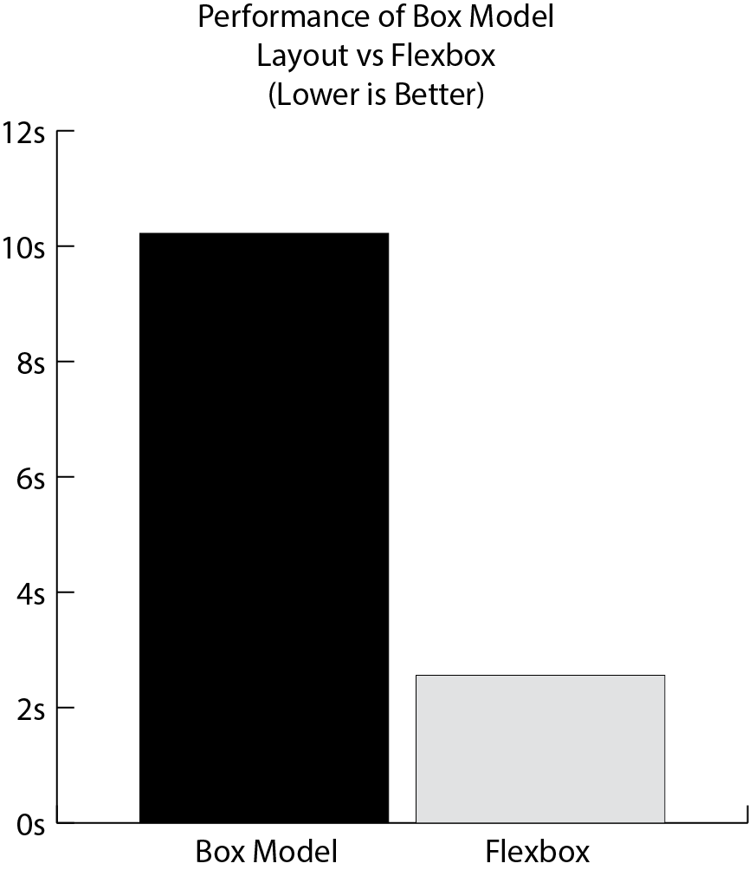
Use Flexbox layout instead of box model
https://css-tricks.com/snippets/css/a-guide-to-flexbox/

Slide 48
Use CSS transitions for animation
transition: transition-property transition-duration transition-timing-function transition-delay
.box{
width: 128px;
height: 128px;
background: #00a;
transition: border-radius 2s ease-out; }
.box:hover{
border-radius: 50%;
}
Notes:
In authors benchmarks vs Jquery Animate
54% less memory used
22% cpu perf increase
There are better libraries that use requestAnimationFrame
For complex situations.
ch8

Slide 49
Thank You

Slide 51
Ch 4:
-

